Slide 1
CPT-S 415
Big Data
Yinghui Wu
EME B45

Slide 2
CPT-S 415
Big Data
Query Processing
Overview: query plan & optimization
Measures of Query Cost
Query optimization: Operators
Notes:
Object.

Slide 3
Query processing: overview

Slide 4

Basic Steps in Query Processing
1. Parsing and translation
2. Optimization
3. Evaluation

Slide 5
Basic Steps in Query Processing
Parsing and translation
  translate the query into its internal form.
  For RDBMS and SQL DB: relational algebra.
  Parser checks syntax, verifies relations
Optimization
  Generate query(evaluation) plan from relational algebra
Evaluation
  The query-execution engine takes a query evaluation plan, executes that plan, and returns the answers to the query.

Slide 6
Example Query
SELECT title, startTime
FROM Movie M, Plays P, Reviews R
WHERE M.title = P.movie AND M.title = R.movie AND P.location ="New York " AND M.actor = “Morgan Freeman” AND R.avgStars >= 3
Query is parsed, generally broken into predicates, then converted into a logical query plan used by the optimizer

Slide 7
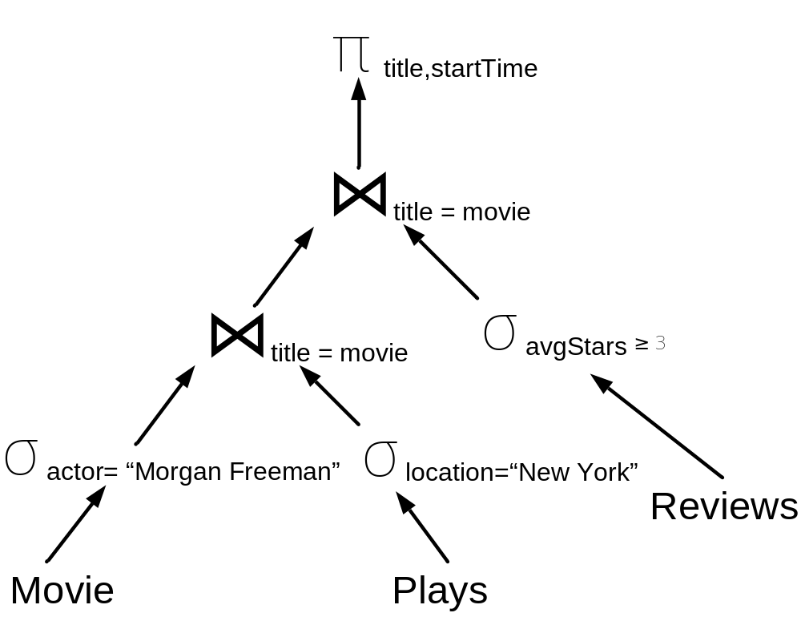
Example Logical Query Plan
SELECT title, startTime
FROM Movie M, Plays P, Reviews R
WHERE M.title = P.movie AND M.title = R.movie AND P.location ="New York " AND M.actor = “Morgan Freeman” AND R.avgStars >= 3

Slide 8
Basic Steps in Query Processing : Optimization
A relational algebra expression may have many equivalent expressions
  E.g., σ_{salary<75000}(∏_{salary}(instructor)) is equivalent to
  ∏_{salary}(σ_{salary<75000}(instructor))
Each relational algebra operation can be evaluated using one of several different algorithms
Annotated expression specifying detailed evaluation strategy is called an evaluation-plan.
  E.g., can use an index on salary to find instructors with salary < 75000,
  or can perform complete relation scan and discard instructors with salary ≥ 75000

Slide 9
Query Optimization
Goal: compare all equivalent query expressions and their low-level implementations (operators)
Can be divided into:
  Plan enumeration (“search”)
  Cost estimation

Slide 10
Foundations of Query Plan Enumeration
Exploit properties of the relational algebra to find equivalent expressions, e.g.:
      (R ⋈ S) ⋈ T = R ⋈ (S ⋈ T)
      σ_{α}(R ⋈ S) = (σ_{α} (R) ⋈ S) if α only refers to R
Assume selection, projection are always done as early as possible
Joins (generally) satisfy principle of optimality:
  Best way to compute R⋈S⋈T takes advantage of the best way of doing a 2 way join, followed by one additional join:
    (R⋈S)⋈T, (R⋈T)⋈S, or (S⋈T)⋈R
(uses optimal way of computing this expression)
Notes:
Each relational algebra operation can be evaluated using one of several different algorithms
Correspondingly, a relational-algebra expression can be evaluated in many ways.

Slide 11
Enumerating Plans
Can formulate as a dynamic programming problem:
  Base case: consider all possible ways of accessing the base tables, with all selections & projections pushed down
  Recursive case (i=2 … number of joins+1): explore all ways to join results with (i-1) tables, with one additional table
    Common heuristic – only considers linear plans
  Then repeat process for all Cartesian products
  Apply grouping and aggregation

Slide 12
Find the Best Join Plan
Complexity: O(3^{n})
Space complexity: O(2^{n})
procedure findbestplan(S) if (bestplan[S].cost ≠ ∞) return bestplan[S]
// else bestplan[S] has not been computed earlier, compute it now
for each non-empty proper subset S1 of S
P1= findbestplan(S1) P2= findbestplan(S - S1)
A = best algorithm for joining results of P1 and P2 cost = P1.cost + P2.cost + cost of A
if cost < bestplan[S].cost
bestplan[S].cost = cost
bestplan[S].plan = “execute P1.plan; execute P2.plan;
join results of P1 and P2 using A”
return bestplan[S]

Slide 13
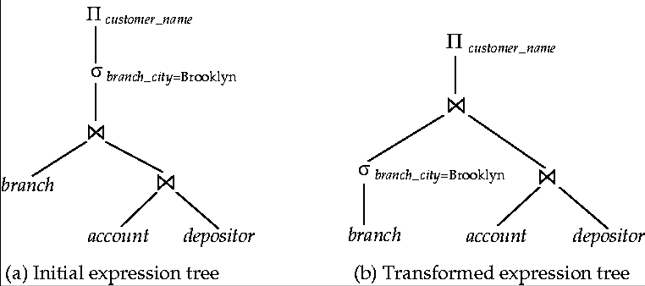
Query Optimization Example
Query: find the names of all customers who have an account at any branch located in Brooklyn
Relational expression:
Pushing selection down

Slide 14
Enumeration of Equivalent Plans
σ (E) = σ_{θ} (σ_{θ} (E))
•
•
•
• σ_{θ}(E₁ X E₂) = E₁
• σ_{θ1}(E₁
θ ∧θ
1 2 1 2
σ_{θ} (σ_{θ} (E)) = σ_{θ} (σ_{θ} (E))
1 2
2
1
(E))K)) = Π (E)
θ ^{E}2
Π _{L} (Π _{L} (K(Π
1 2
Ln
L
1
_{θ2} E₂) = E₁
θ1∧ θ2 ^{E}2
• E_{1 θ} E₂ = E₂
• (E₁ E₂)
• (E_{1 θ1} E₂)
•
•
θ ^{E}1
E₃ = E₁ (E₂
E₃)
θ2∧ θ3 ^{(E}2
θ2∧ θ3 ^{E}3 ^{= E}1
θ2 ^{E}3⁾
^{σ}θ0^{(E}1
_{θ} E₂) = (σ_{θ0}(E₁))
θ ^{E}2
^{σ}θ1∧θ2 ^{(E}1
_{θ} E₂) = (σ_{θ1}(E₁))
_{θ} (σ_{θ2} (E₂))

Slide 15
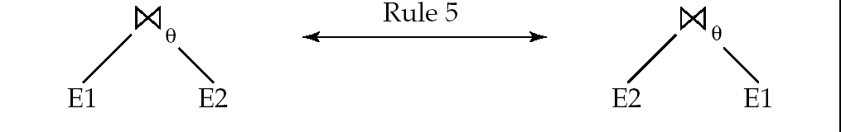
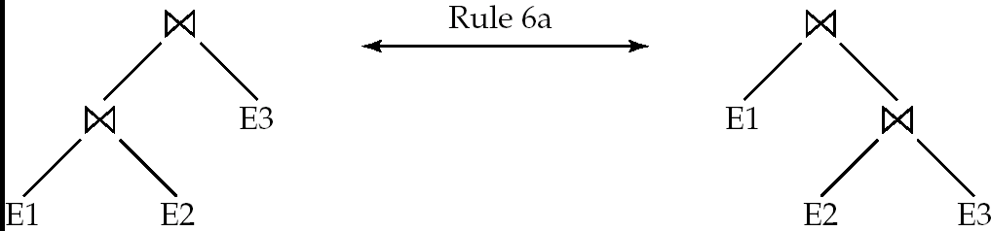
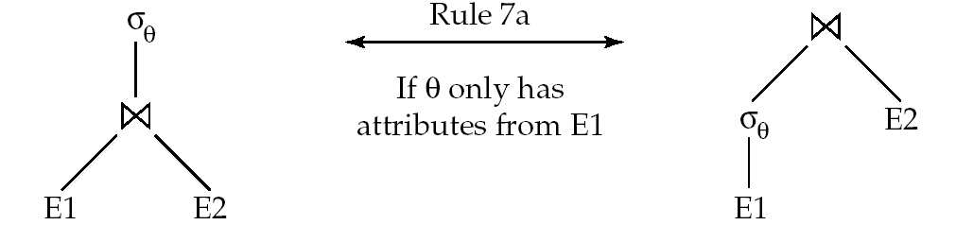
Enumeration of Equivalent Plans
•
•
• E₁ ∪ E₂ = E₂ ∪ E₁
• E₁ ∩ E₂ = E₂ ∩ E₁
• (E₁ ∪ E₂) ∪ E₃ = E₁ ∪ (E₂ ∪ E₃)
• (E₁ ∩ E₂) ∩ E₃ = E₁ ∩ (E₂ ∩ E₃)
σ_{θ} (E₁ – E₂) = σ_{θ} (E₁) – σ_{θ}(E₂) and similarly for ∪ and ∩
σ_{θ} (E₁ – E₂) = σ_{θ}(E₁) – E₂ and similarly for ∩ , but not for ∪
• Π_{L}(E₁ ∪ E₂) = (Π_{L}(E₁)) ∪ (Π_{L}(E₂))
∏L ∪L
(E_{1 θ} E₂ ) = (∏_{L} (E₁))
(E₁ E )
θ ^{(∏}L
(E₂ ))
1 2
1
2
∏
= ∏ ∏
∏
θ
((
(E₁ )) (
(E₂ )))
L ∪L
2 L ∪L L ∪L
θ L ∪L
1 2 1 2 1 3
2 4

Slide 16
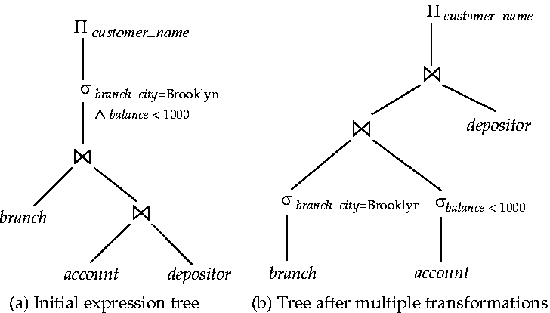
Example

Slide 17
Query Optimization
Goal: compare all equivalent query expressions and their low-level implementations (operators)
Can be divided into:
  Plan enumeration (“search”)
  Cost estimation
How to measure?

Slide 18
Query optimization：cost analysis

Slide 19
Measures of Query Cost
Cost is generally measured as total elapsed time for answering query
  Many factors contribute to time cost
    disk accesses, CPU, or network communication
Disk access is the predominant cost (I/O). Measured by
  Number of seeks * average-seek-cost
  Number of blocks read * average-block-read-cost
  Number of blocks written * average-block-write-cost
    Cost to write a block is greater than cost to read a block
      data is read back after being written to ensure that the write was successful

Slide 20
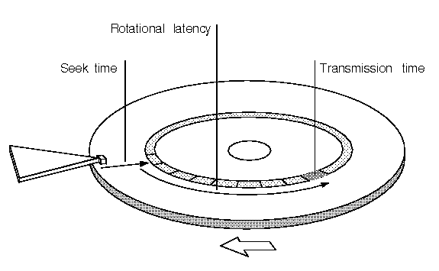
Measures of Query Cost (Cont.)
I/O cost
  Use the number of block transfers from disk and the number of seeks as the cost measures
  t_{T} – time to transfer one block
  t_{S} – time for one seek
  Cost for b block transfers plus S seeks
  b * t_{T} + S * t_{S}
CPU cost
  for main-memory algorithms
Index are often used to reduce cost! – a flashback

Slide 21
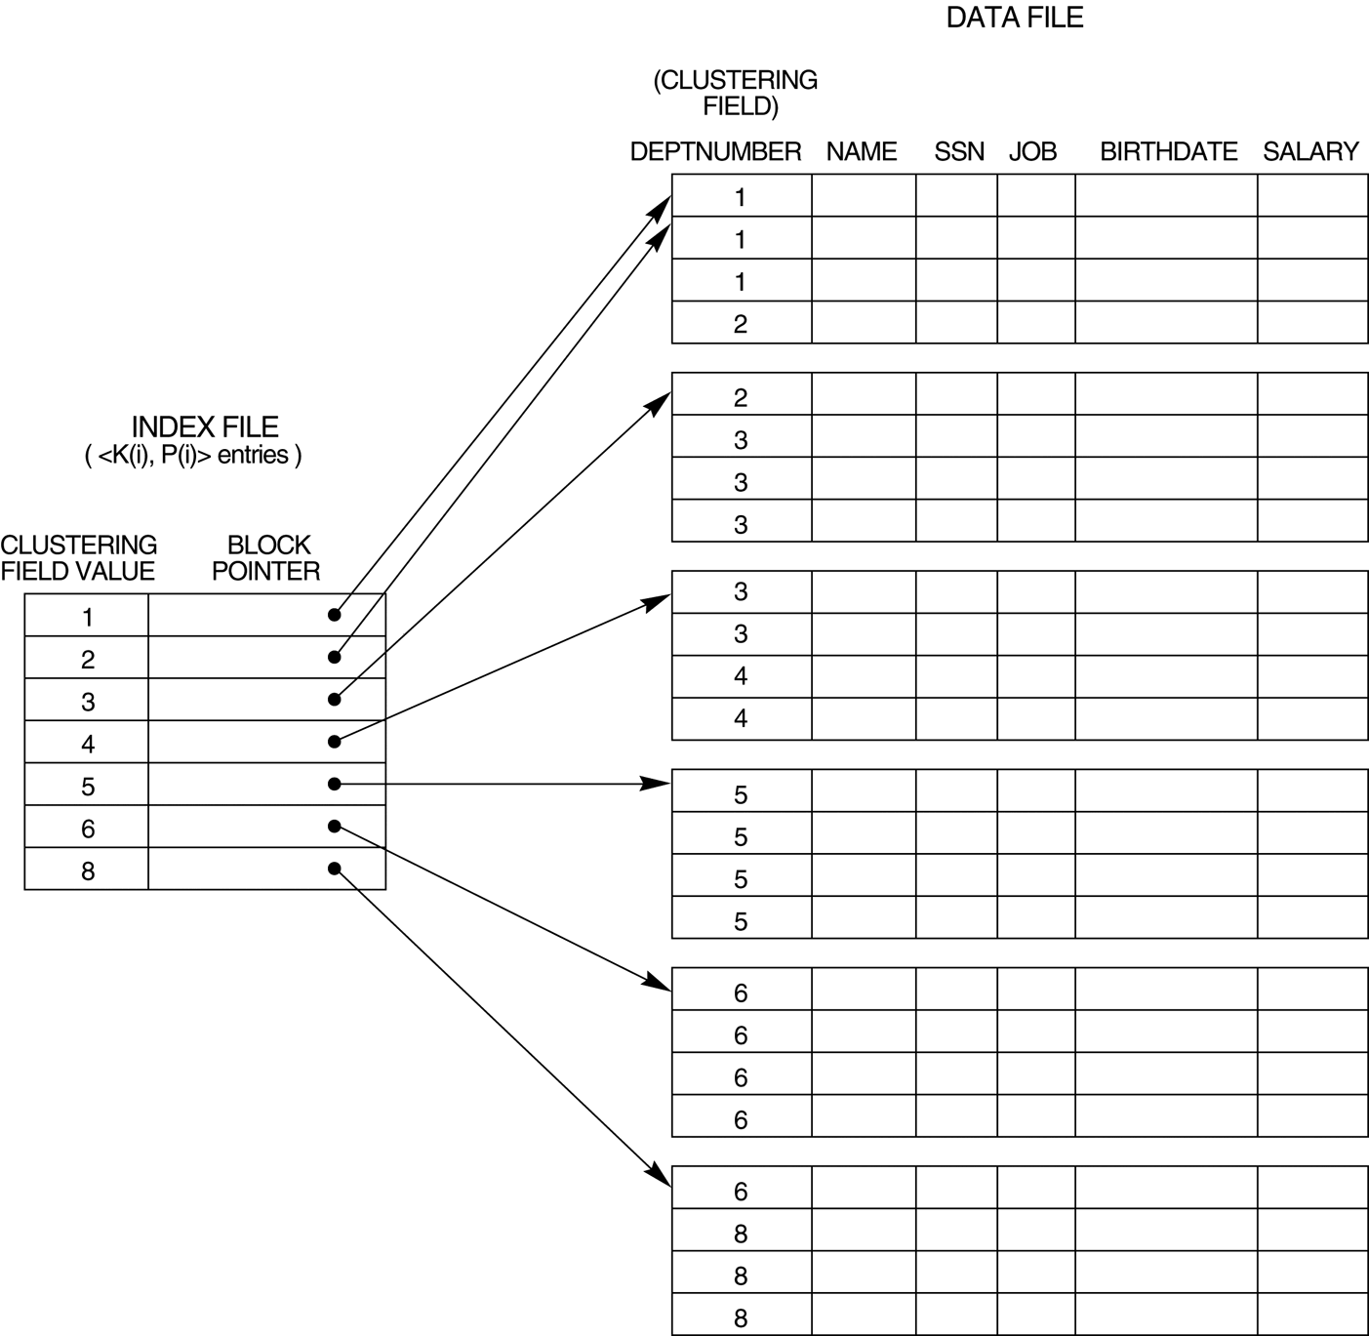
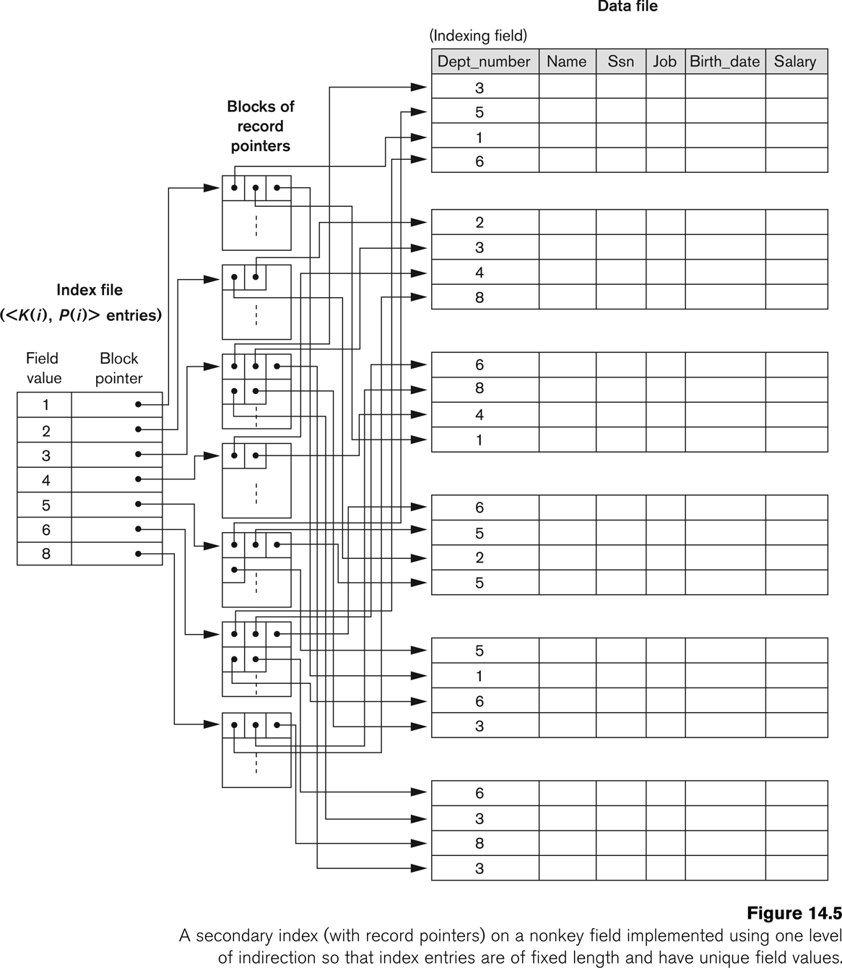
Single-level index: Primary and Secondary

Slide 22

Multi-level index: Example of B⁺-Tree

Slide 23
Catalog information for cost estimation
NR: # of tuples in a relation R
BR: # of blocks that contain tuples of relation R
SR: size of tuple of R
FR: blocking factor; # of tuples from R that fit into one block: FR=NR/BR
V(A, R): # of distinct value for attribute A in R.
Sc(A,R): selectivity of attribute A = average number of tuples of R that satisfy an equality condition on A; Sc(A,R)=NR/V(A,R)

Slide 24
Query Plan Cost Estimation
  For each expression, predict the cost and output size given what we know about the inputs
Requires significant information:
  A cost formula for each algorithm, in terms of disk I/Os, CPU speed, …
  Calibration parameters for host machine performance
  Information about the distributions of join and grouping columns

Slide 25
Query optimization：
case study: selection

Slide 26
Selections
Selection: File scan
  A1: Linear scan: Scan each file block and test. Cost: BR* t_{T} + t_{S}
Selection: Index
  A2 (primary index, equality on key). Retrieve a single record that satisfies the corresponding equality condition
    Cost = (h_{i} + 1) * (t_{T} + t_{S}) -- h_{i}: height of the (B+-tree)
  A3 (primary index, equality on Nonkey) Retrieve multiple records.
    Records will be on consecutive blocks
      Let b = number of blocks containing matching records
    Cost = h_{i} (t_{T} + t_{S}) + b* t_{T}
    =h_{i} (t_{T} + t_{S}) + Sc(A,R)/FR * t_{T}
NR: # of tuples
BR: # of blocks
SR: size of tuple of R
FR: block size
Sc(A,R): selectivity

Slide 27
Selections Using Indices
A4 (secondary index, equality on nonkey).
  Retrieve a single record if the search-key is a candidate key
    Cost = (h_{i} + 1) * (t_{T} + t_{S})
  Retrieve multiple records if search-key is not a candidate key
    each of n matching records may be on a different block
    Cost = (h_{i} + n) * (t_{T} + t_{S})
      Can be very expensive!
NR: # of tuples
BR: # of blocks
SR: size of tuple of R
FR: block size
Sc(A,R): selectivity

Slide 28
Selections Involving Comparisons
Comparison: σ_{A≤V} (r) or σ_{A ≥ V}(r)
  a linear file scan,
  or by using indices in the following ways:
A5 (primary index, comparison). (Relation is sorted on A)
    For σ_{A ≥ V}(r) use index to find first tuple ≥ v and scan relation sequentially from there
    For σ_{A≤V} (r) just scan relation sequentially till first tuple > v; do not use index
A6 (secondary index, comparison).
    scan index sequentially to find pointers to records
    retrieve records that are pointed to
      requires an I/O for each record
      Linear file scan may be cheaper
NR: # of tuples
BR: # of blocks
SR: size of tuple of R
FR: block size
Sc(A,R): selectivity

Slide 29
Implementation of Complex Selections
Conjunction: σ_{θ1}∧ _{θ2}∧. . . _{θn}(r)
A7 (conjunctive selection using one index).
  Select a combination of θ_{i} that results in the least cost for σ_{θi} (r).
  Test other conditions on tuple after fetching it into memory buffer.
A8 (conjunctive selection using composite index).
  Use appropriate composite (multiple-key) index if available.
A9 (conjunctive selection by intersection of identifiers).
  Requires indices with record pointers.
  Use corresponding index for each condition, and take intersection of all the obtained sets of record pointers.
  Then fetch records from file
  If some conditions do not have appropriate indices, apply test in memory.

Slide 30
Algorithms for Complex Selections
Disjunction:σ_{θ1}∨ _{θ2} ∨. . . _{θn} (r).
A10 (disjunctive selection by union of identifiers).
  Applicable if all conditions have available indices.
    Otherwise use linear scan.
  Use corresponding index for each condition, and take union of all the obtained sets of record pointers.
  Then fetch records from file
Negation: σ_{¬θ}(r)
  Use linear scan on file
    If very few records satisfy ¬θ, and an index is applicable to θ
    Find satisfying records using index and fetch from file

Slide 31
Query optimization：
case study: Sorting

Slide 32
Sorting
We may build an index on the relation, and then use the index to read the relation in sorted order. May lead to one disk block access for each tuple.
For relations that fit in memory, techniques like quicksort can be used. For relations that don’t fit in memory, external
sort-merge is a good choice.

Slide 33
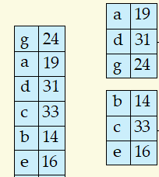
External Sort-Merge
Let M denote memory size (in pages).
Create sorted runs. Let i be 0 initially.
Repeatedly do the following till the end of the relation:
(a) Read M blocks of relation into memory
(b) Sort the in-memory blocks
(c) Write sorted data to run file R_{i}; increment i.
Let the final value of i be N
Merge the runs (next slide)…..

Slide 34
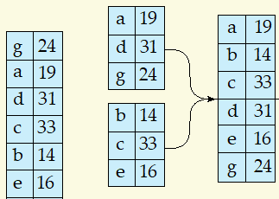
External Sort-Merge (Cont.)
Merge the runs (N-way merge). Assume that N < M.
  Use N blocks of memory to buffer input runs, and 1 block to buffer output. Read the first block of each run into its buffer page
  repeat
    Select the first record (in sort order) among all buffer pages
    Write the record to the output buffer. If the output buffer is full write it to disk.
    Delete the record from its input buffer page.
    If the buffer page becomes empty then
    read the next block (if any) of the run into the buffer.
  until all input buffer pages are empty:

Slide 35
External Sort-Merge (Cont.)
If N ≥ M, several merge passes are required.
  In each pass, contiguous groups of M - 1 runs are merged.
  A pass reduces the number of runs by a factor of M -1, and creates runs longer by the same factor.
    E.g. If M=11, and there are 90 runs, one pass reduces the number of runs to 9, each 10 times the size of the initial runs
  Repeated passes are performed till all runs have been merged into one.

Slide 36

Example: External Sorting Using Sort-Merge

Slide 37
External Merge Sort (Cont.)
Cost analysis:
  1 block per run leads to too many seeks during merge
    Instead use b_{b} buffer blocks per run
      ➔ read/write b_{b} blocks at a time
    Can merge ⎣M/b_{b}⎦–1 runs in one pass
  Total number of merge passes required: ⎡log _{⎣M/bb⎦–1}(b_{r}/M)⎤.
  Block transfers for initial run creation as well as in each pass is 2b_{r}
    for final pass, we don’t count write cost
      we ignore final write cost for all operations since the output of an operation may be sent to the parent operation without being written to disk
    Thus total number of block transfers for external sorting:
    b_{r} ( 2 ⎡log _{⎣M/bb⎦–1} (b_{r} / M)⎤ + 1) ⎡
  Seeks: next slide
NR: # of tuples
BR: # of blocks
SR: size of tuple of R
FR: block size
Sc(A,R): selectivity

Slide 38
External Merge Sort (Cont.)
Cost of seeks
  During run generation: one seek to read each run and one seek to write each run
    2 ⎡b_{r} / M⎤
  During the merge phase
    Need 2 ⎡b_{r} / b_{b}⎤ seeks for each merge pass
      except the final one which does not require a write
    Total number of seeks:
    2 ⎡b_{r} / M⎤ + ⎡b_{r} / b_{b}⎤ (2 ⎡log_{⎣M/bb⎦–1}(b_{r} / M)⎤ -1)

Slide 39
Query optimization：
case study: Join

Slide 40
Join Operation
Several different algorithms to implement joins
  Nested-loop join
  Block nested-loop join
  Indexed nested-loop join
  Merge-join
  Hash-join
Choice based on cost estimate
Examples use the following information
  Number of records of student: 5,000 takes: 10,000
  Number of blocks of student: 100 takes: 400

Slide 41
Nested-Loop Join
To compute the theta join r _{θ} s
for each tuple t_{r} in r do begin
for each tuple t_{s} in s do begin
test pair (t_{r},t_{s}) to see if they satisfy the join condition θ
if they do, add t_{r} • t_{s} to the result.
  end
end
r is called the outer relation and s the inner relation of the join.
Requires no indices and can be used with any kind of join condition.
Expensive since it examines every pair of tuples in the two relations.

Slide 42
Nested-Loop Join (Cont.)
In the worst case, if enough memory only to hold one block of each relation, the estimated cost is
n_{r} ∗ b_{s} + b_{r} block transfers, plus
n_{r} + b_{r} seeks
If the smaller relation fits entirely in memory, use that as the inner relation.
  Reduces cost to b_{r} + b_{s} block transfers and 2 seeks
Assuming worst case memory availability cost estimate is
  with student as outer relation:
    5000 ∗ 400 + 100 = 2,000,100 block transfers,
    5000 + 100 = 5100 seeks
  with takes as the outer relation
    10000 ∗ 100 + 400 = 1,000,400 block transfers and 10,400 seeks
If smaller relation (student) fits entirely in memory, the cost estimate will be 500 block transfers.
Block nested-loops algorithm (next slide) is preferable.

Slide 43
Block Nested-Loop Join
Variant of nested-loop join in which every block of inner relation is paired with every block of outer relation.
for each block B_{r} of r do begin
for each block B_{s} of s do begin
for each tuple t_{r} in B_{r} do begin
for each tuple t_{s} in B_{s} do begin
Check if (t_{r},t_{s}) satisfy the join condition
if they do, add t_{r} • t_{s} to the result.
end
end
end
end

Slide 44
Block Nested-Loop Join (Cont.)
Worst case estimate: b_{r} ∗ b_{s} + b_{r} block transfers + 2 * b_{r} seeks
  Each block in the inner relation s is read once for each block in the outer relation
Best case: b_{r} + b_{s} block transfers + 2 seeks.
  Use index on inner relation if available (next slide)

Slide 45
Indexed Nested-Loop Join
For each tuple t_{r} in the outer relation r, use the index to look up tuples in s that satisfy the join condition with tuple t_{r}.
Worst case: buffer has space for only one page of r, and, for each tuple in r, we perform an index lookup on s.
Cost of the join: b_{r} (t_{T} + t_{S}) + n_{r} ∗ c
  Where c is the cost of traversing index and fetching all matching s tuples for one tuple or r
  c can be estimated as cost of a single selection on s using the join condition.
If indices are available on join attributes of both r and s,
use the relation with fewer tuples as the outer relation.

Slide 46
Example of Nested-Loop Join Costs
Compute student takes, with student as the outer relation.
Let takes have a primary B⁺-tree index on the attribute ID, which contains 20 entries in each index node.
Since takes has 10,000 tuples, the height of the tree is 4, and one more access is needed to find the actual data
student has 5000 tuples
Cost of block nested loops join
  400*100 + 100 = 40,100 block transfers + 2 * 100 = 200 seeks
    assuming worst case memory
    may be significantly less with more memory
Cost of indexed nested loops join
  100 + 5000 * 5 = 25,100 block transfers and seeks.
  CPU cost likely to be less than that for block nested loops join

Slide 47

Merge-Join
Sort both relations on their join attribute (if not already sorted on the join attributes).
Merge the sorted relations to join them
  Join step is similar to the merge stage of the sort-merge algorithm.
  Main difference is handling of duplicate values in join attribute — every pair with same value on join attribute must be matched

Slide 48
Merge-Join (Cont.)
Can be used only for equi-joins and natural joins
Each block needs to be read only once (assuming all tuples for any given value of the join attributes fit in memory
Thus the cost of merge join is:
b_{r} + b_{s} block transfers + ⎡b_{r} / b_{b}⎤ + ⎡b_{s} / b_{b}⎤ seeks
  + the cost of sorting if relations are unsorted.
hybrid merge-join: If one relation is sorted, and the other has a secondary B⁺-tree index on the join attribute
  Merge the sorted relation with the leaf entries of the B⁺-tree .
  Sort the result on the addresses of the unsorted relation’s tuples
  Scan the unsorted relation in physical address order and merge with previous result, to replace addresses by the actual tuples
    Sequential scan more efficient than random lookup

Slide 49
Hash-Join
Applicable for equi-joins and natural joins.
A hash function h is used to partition tuples of both relations
h maps JoinAttrs values to {0, 1, ..., n}, where JoinAttrs denotes the common attributes of r and s used in the natural join.
  r₀, r₁, . . ., r_{n} denote partitions of r tuples
    Each tuple t_{r} ∈ r is put in partition r_{i} where i = h(t_{r} [JoinAttrs]).
  s₀,, s₁. . ., s_{n} denotes partitions of s tuples
    Each tuple t_{s} ∈s is put in partition s_{i}, where i = h(t_{s} [JoinAttrs]).

Slide 50

Hash-Join (Cont.)

Slide 51
Hash-Join (Cont.)
r tuples in r_{i} need only to be compared with s tuples in s_{i} Need not be compared with s tuples in any other partition, since:
  an r tuple and an s tuple that satisfy the join condition will have the same value for the join attributes.
  If that value is hashed to some value i, the r tuple has to be in r_{i} and the s tuple in s_{i}.

Slide 52
Hash-Join Algorithm
The hash-join of r and s is computed as follows.
1. Partition the relation s using hashing function h. When partitioning a relation, one block of memory is reserved as the output buffer for each partition.
2. Partition r similarly.
3. For each i:
  (a) Load s_{i} into memory and build an in-memory hash index on it using the join attribute. This hash index uses a different hash function than the earlier one h.
  (b) Read the tuples in r_{i} from the disk one by one. For each tuple t_{r} locate each matching tuple t_{s} in s_{i} using the in-memory hash index. Output the concatenation of their attributes.
Relation s is called the build input and r is called the probe input.

Slide 53
Hash-Join algorithm (Cont.)
The # of partitions n and the hash function h is chosen such that each s_{i} should fit in memory.
  Typically n is chosen as ⎡b_{s}/M⎤ * f where f is a “fudge factor”, typically around 1.2
  The probe relation partitions r_{i} need not fit in memory
Recursive partitioning required if number of partitions n is greater than number of pages M of memory.
  instead of partitioning n ways, use M – 1 partitions for s
  Further partition the M – 1 partitions using a different hash function
  Use same partitioning method on r
  Rarely required: e.g., with block size of 4 KB, recursive partitioning not needed for relations of < 1GB with memory size of 2MB, or relations of < 36 GB with memory of 12 MB

Slide 54
Cost of Hash-Join
If recursive partitioning is not required: cost of hash join is
3(b_{r} + b_{s}) +4 ∗ n_{h} block transfers +
2( ⎡b_{r} / b_{b}⎤ + ⎡b_{s} / b_{b}⎤) seeks
If recursive partitioning required:
  number of passes required for partitioning build relation s to less than M blocks per partition is ⎡log_{⎣M/bb⎦–1}(b_{s}/M)⎤
  best to choose the smaller relation as the build relation.
  Total cost estimate is:
  2(b_{r} + b_{s}) ⎡log_{⎣M/bb⎦–1}(b_{s}/M)⎤ + b_{r} + b_{s} block transfers +
  2(⎡b_{r} / b_{b}⎤ + ⎡b_{s} / b_{b}⎤) ⎡log_{⎣M/bb⎦–1}(b_{s}/M) ⎤ seeks
If the entire build input can be kept in main memory no partitioning is required
  Cost estimate goes down to b_{r} + b_{s}.

Slide 55
Example of Cost of Hash-Join
instructor teaches
Assume that memory size is 20 blocks
b_{instructor}= 100 and b_{teaches} = 400.
instructor is to be used as build input. Partition it into five partitions, each of size 20 blocks. This partitioning can be done in one pass.
Similarly, partition teaches into five partitions,each of size 80. This is also done in one pass.
Therefore total cost, ignoring cost of writing partially filled blocks:
  3(100 + 400) = 1500 block transfers +
  2( ⎡100/3⎤ + ⎡400/3⎤) = 336 seeks

Slide 56
Complex Joins
Join with a conjunctive condition:
r _{θ1∧ θ 2∧... ∧ θ n} s
  Either use nested loops/block nested loops, or
  Compute the result of one of the simpler joins r _{θi} s
    final result comprises those tuples in the intermediate result that satisfy the remaining conditions
  θ₁ ∧ . . . ∧ θ_{i –1} ∧ θ_{i +1} ∧ . . . ∧ θ_{n}
Join with a disjunctive condition
  r _{θ1 ∨ θ2 ∨... ∨ θn} s
  Either use nested loops/block nested loops, or
  Compute as the union of the records in individual joins r _{θ i} s:
  (r _{θ1} s) ∪ (r _{θ2} s) ∪ . . . ∪ (r _{θn} s)

Slide 57



“Big O” notation
Given two functions, f and g, say that “f is of order g” if
  there is a constant c, and
  a value x₀
such that
Apart from a fixed multiplicative constant, the function g is an
  upper bound on the function f
  valid for large values of its argument.
Notation: write to mean “f is of order g”.
Sometimes write to remind us the arguments.

Slide 58
Example: N-by-N matrix, N-by-1 vector, multiply
Y = zeros(N,1);
for i=1:N
Y(i) = 0.0;
for j=1:N
Y(i) = Y(i) + A(i,j)*x(j);
end
end
initialize space, c₁N
initialize “for” loop, c₂N
Scalar assignment, c₃
initialize “for” loop, c₂N
N times
c₄
N times
End of loop, return/exit, c₅
End of loop, return/exit, c₅
Total = c₁N+c₂N+N(c₃+c₂N+N(c₄+c₅)+c₅)
= (c₂+c₄+c₅)N² + (c₁+c₂+c₃+c₅)N
= c₆N² + c₇N

